Slide 1
Random Variable & Probability

Slide 2
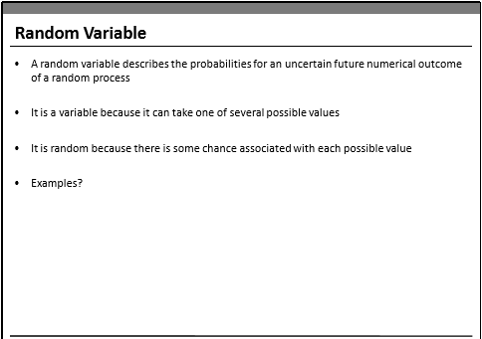

Slide 3
Discrete Random Variables : Random variables that can assume a countable number of values. If a random variable can only take a finite
number of distinct values, it must be discrete
Ex : number of defective light bulbs in a box, the number of children in a family
Continuous Random Variables: Random variables that can assume any value corresponding to any of the points contained in one or more intervals They are usually measurements. Things like heights, weights, and time are continuous random variables
Ex: time it takes to complete a race or the length of time between arrivals at a hospital clinic.

Slide 4
Z- Scores
z-score makes use of the mean and the standard deviation of the data set in order to specify the relative location of a measurement.
It represents the distance between a given data point and the mean, expressed in standard deviations. The score is also known as “standardizing” the data point
Large z-scores tell us that the measurement is larger than almost all other measurements in the data set.
Similarly, a small z-score tells us that the measurement is small than all other measurements.
If a score is 0, then the observation lies on the mean.

Slide 5
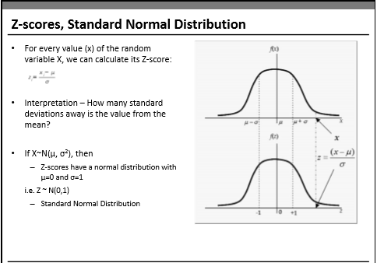
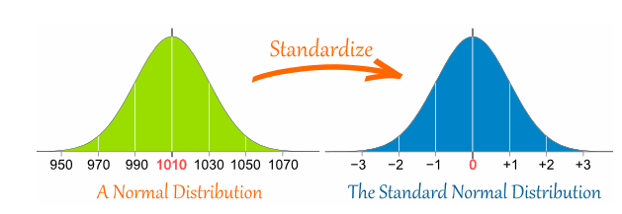

Slide 6
Probability Distributions
Continuous Probability Distributions
Discrete Probability Distribution

Slide 7
Probability Distributions
Discrete Probability Distribution: The probability distribution of a discrete random variable is a graph, table or formula that specifies the probability associated with each possible value the random variable can assume.
Discrete Probability distribution properties:
• The sum of all probabilities in a distribution sum to 1.
• Each value has a probability between 0 and 1.

Slide 8
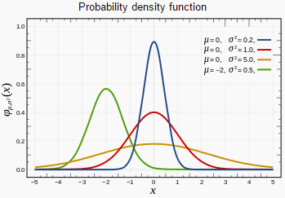
Continuous Probability Distributions
Continuous Probability Distribution: We can describe the probability distribution of a continuous random variable using a probability density function. A probability density function f(x) is a function that you can use to find the
probabilities of a continuous variable across a range of values. It tells us
what the shape of the probability distribution is.
Probability is all about how likely things are to happen, and the frequency tells you how often values occur. The higher the relative frequency, the higher the probability of that value occurring

Slide 9
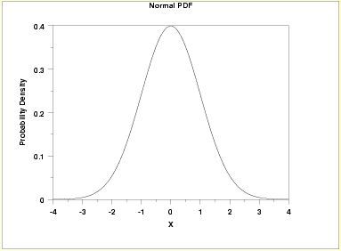
Normal Distribution
It is one of the most famous statistical distributions in use .The normal distribution is a continuous probability distribution Several phenomenon are modelled with the normal distribution.
For example : Heights of people are normally distributed as well as possible blood pressure levels for people.

Slide 10
Normal Distribution
The Properties of the Normal Distribution:
A continuous random variable X has a normal distribution if its values fall into a smooth curve that is bell shaped.
• Every normal distribution has its own mean (denoted μ) and its own standard deviation (denoted σ). The normal distribution is defined by its mean and standard deviation.
• Its shape of the normal distribution is symmetric around the mean.
• The mean, median, and the mode of a normal distribution are equal.
• The area under the curve is 1.
• Normal distributions are denser in the center and less so in the tails.
• Since the normal distribution is mound shaped, it follows the empirical rule i.e.
i) 68% of the area of a normal distribution is within one standard deviation of the mean;
ii) 95% of the data are within 2 standard deviations of the mean;
iii) 99.7% of the data are within 3 standard deviations of the mean.

Slide 11
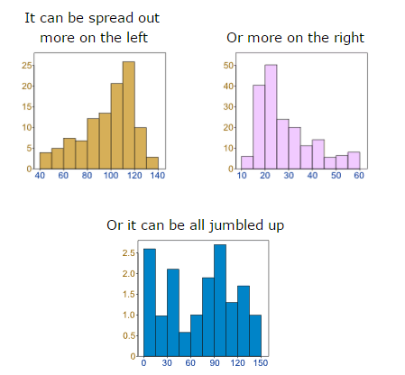
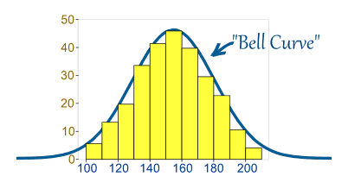
Normal Distribution
But there are many cases where the data tends to be around a central value with no bias left or right, and it gets close to a "Normal Distribution" like this
Data can be "distributed" (spread out) in different ways.
Sample(1:10000,100)

Slide 12
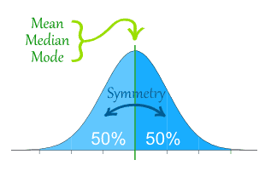
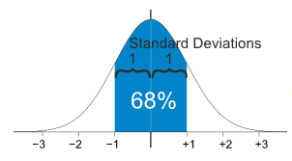
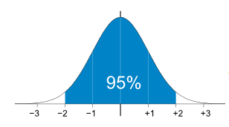
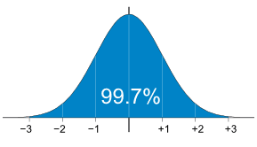

Normal Distribution
The Normal Distribution has
mean = median = mode
Symmetry about the center
50% of values less than the mean and 50% greater than the mean
95% of values are within 2 standard deviations of the mean
99.7% of values are within 3 standard deviations of the mean
68% of values are within 1 standard deviation of the mean

Slide 13
